Slide 1

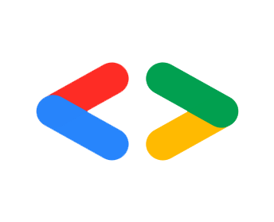




Slide 7
Google Developer Student Club

Slide 10


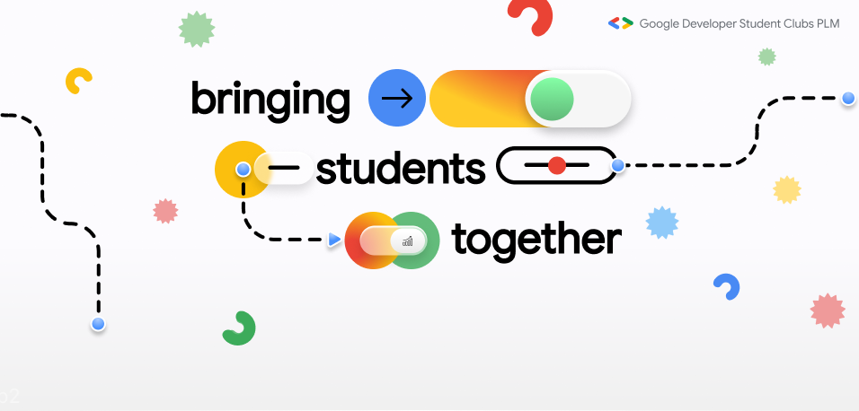
Home
About
Community
Log in

Slide 11


Home
About
Community
Log in
WELCOME TO GDSC (PLM)

Slide 12
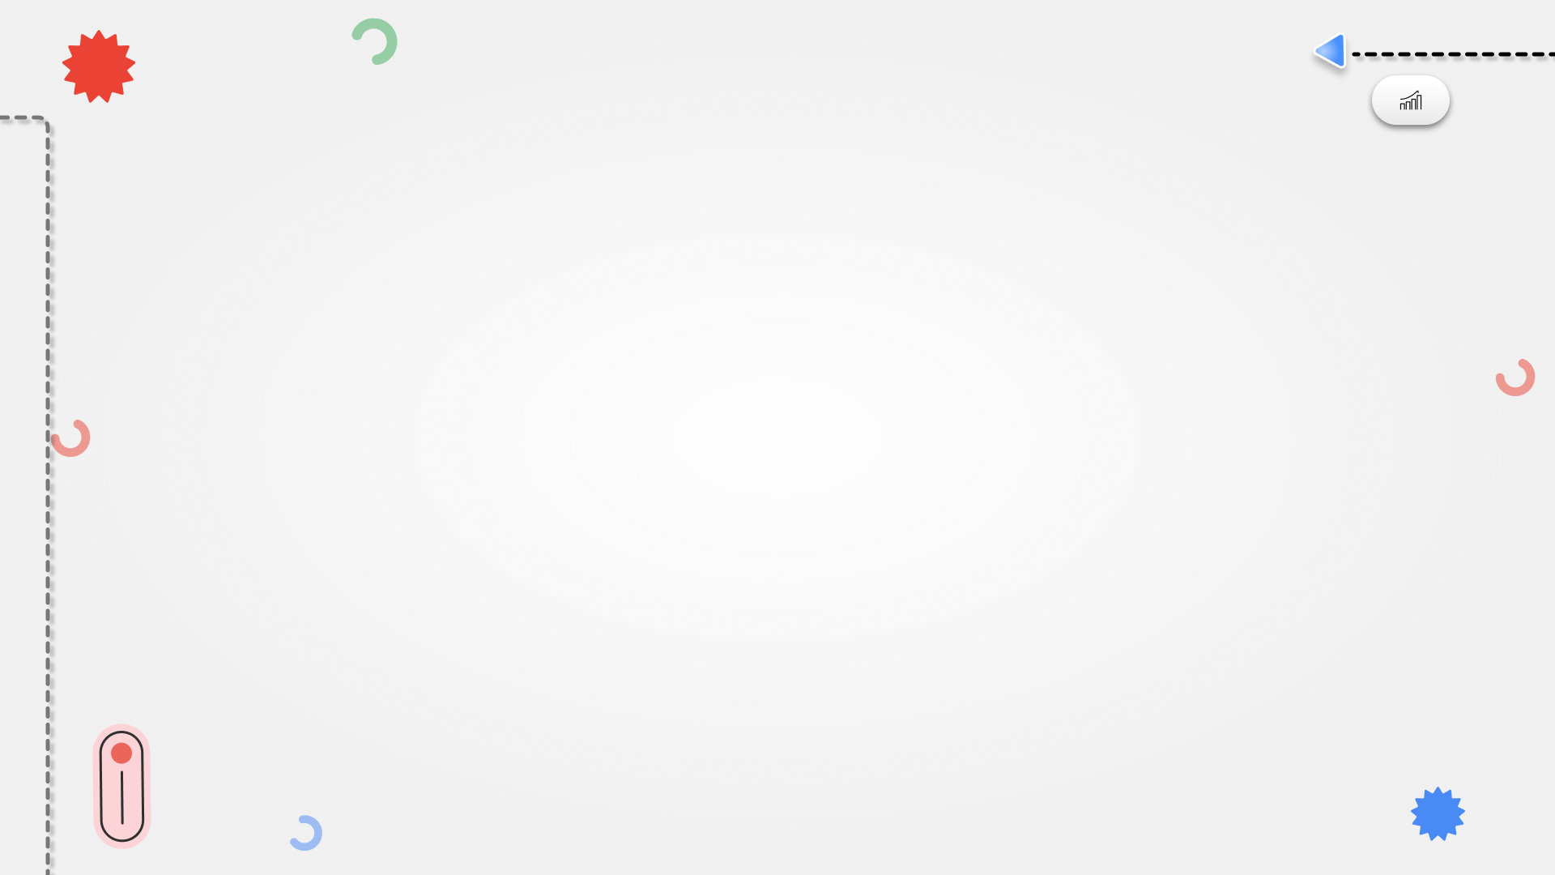
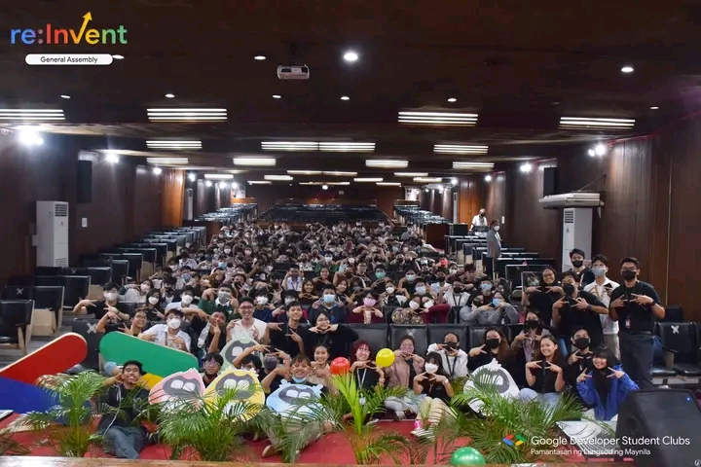
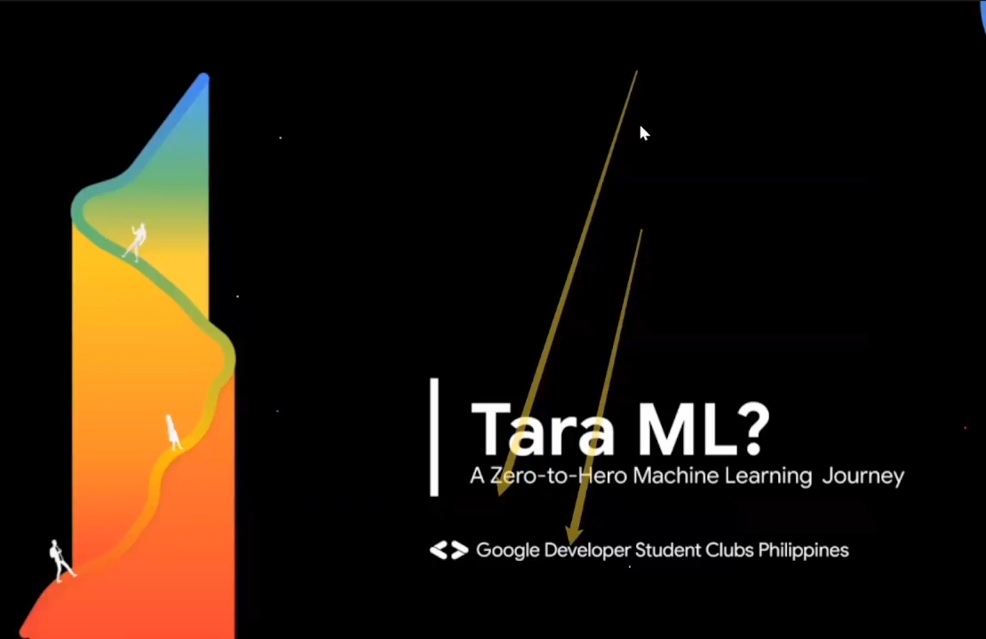
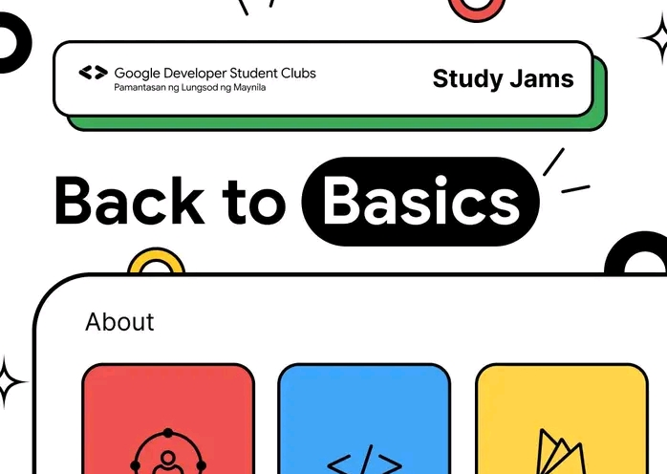
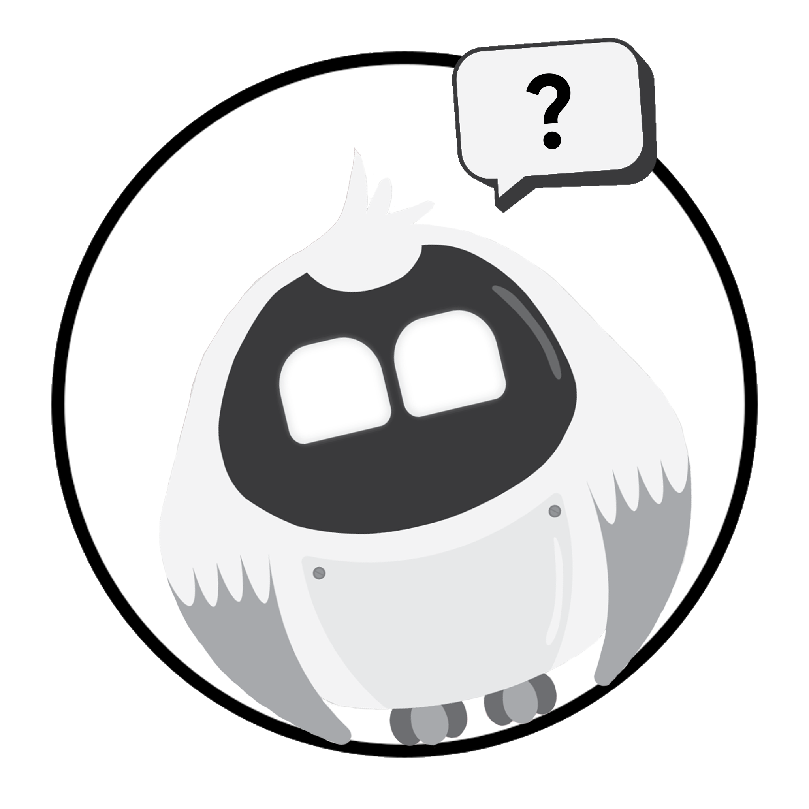
Home
About
Community
Log in
PAST EVENTS
Re:Invent
(November 24, 2022)
Tara ML?
(December 02, 2022)
Back to Basics
(December 09, 2022)
FUTURE EVENTS

Slide 13
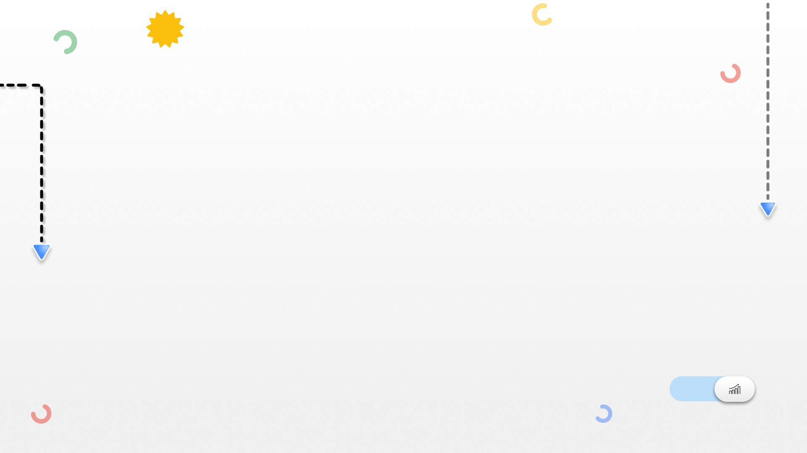

Home
About
Community
Log in
What is GDSC?
Google Developer Student Clubs (GDSC) are community groups for college and university students interested in Google developer technologies. In GDSC, students grow their knowledge in a peer-to-peer learning environment and build solutions for local businesses and their community. GDSC Philippines consists of a group of students from the Philippines whose aim is to bridge the gap between theory and practical application for Filipino student developers.
What is the goal of GDSC?
Bringing student together in building meaningful solutions for the community.

Slide 14
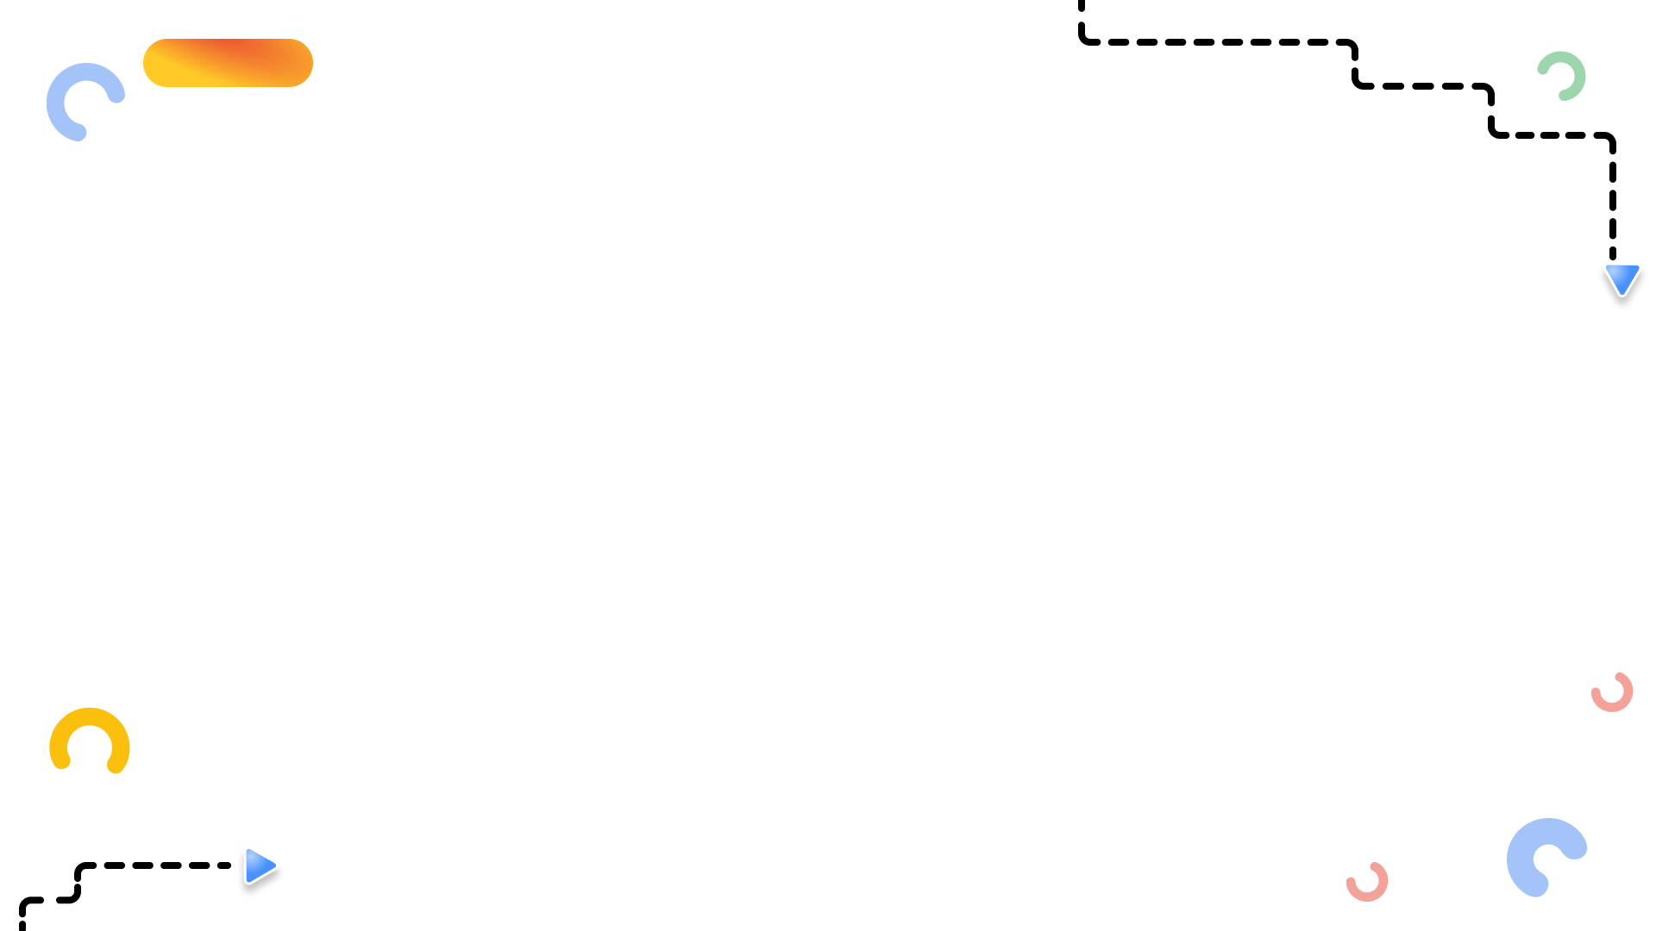



Home
About
Community
Log in
VISION
MISSION
To be a distinguished community group in the local student developer communities.
To impact positive and enjoyable experiences that people can look back and appreciate.
To uphold the legacy of the club by entrusting its future to the next generation of leaders.
To lead a college-based community group for students who are interested in developer technologies and for students who aspire to be better developers.
To communicate with our members with utmost respect, integrity, accessibility, and dedication.
To implement innovative ways to bring out the potential of our members.
To facilitate the growth of our members by providing social and learning opportunities related to developer technologies with the help of events such as workshops, forums, and tutorials.
Follow Us:
Contact Us:
Instagram
dsc.haribon@gmail.com
©Copyright. All rights reserved
Facebook
YouTube

Slide 15
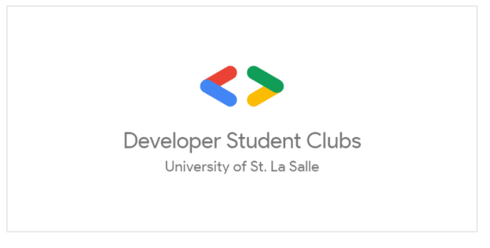
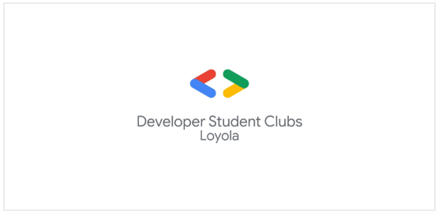

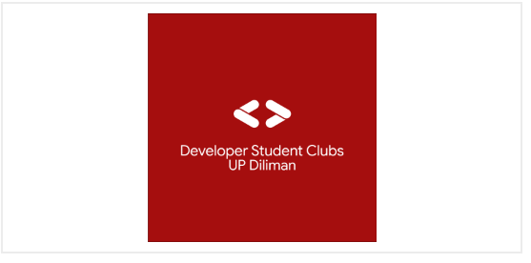






Community
Home
About
Log in
Partners
Local Sponsors

Slide 16
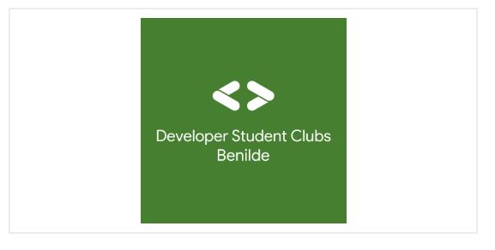
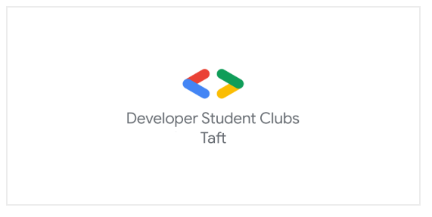
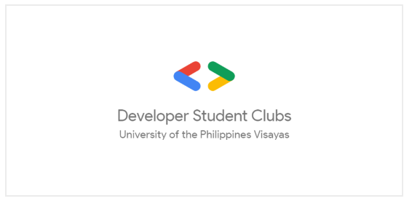
Community
Home
About
Log in
Partners
Local Sponsors

Slide 17
Community
Home
About
Log in
Partners
Local Sponsors

Slide 18
Home
About
Community
Log in
WELCOME TO GDSC (PLM)

Slide 19
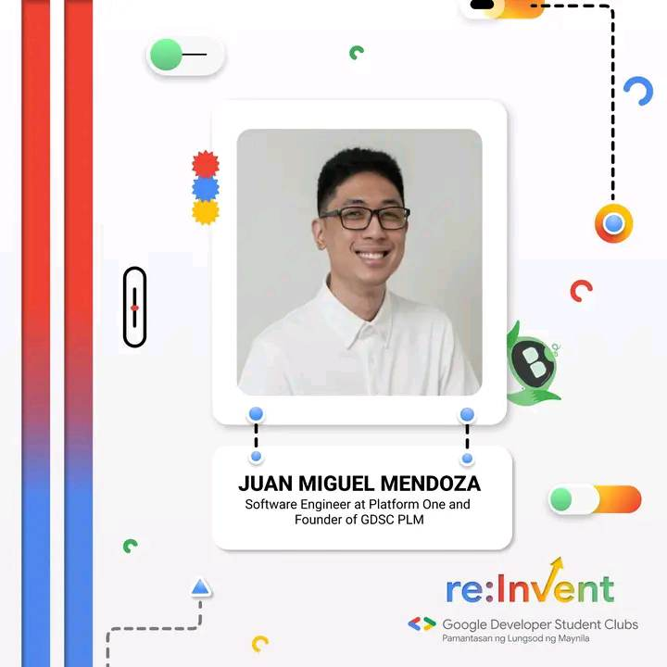
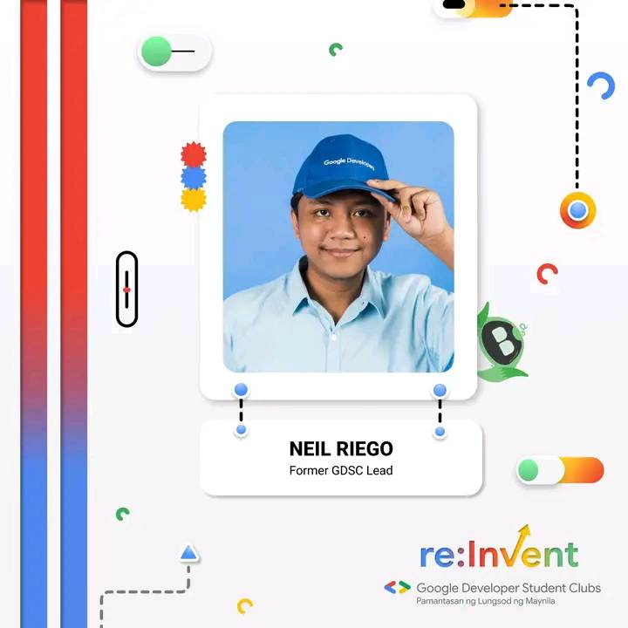
About
Home
Community
Log in
What is GDSC PLM?
Google Developer Student Clubs PLM is a duly constituted organization of Pamantasan ng Lungsod ng Maynila that aims to build great solutions, transform communities, and connect Haribons with diverse backgrounds and different majors through technology.
A Google Developer Student Clubs chapter for Pamantasan ng Lungsod ng Maynila (University of the City of Manila)

Slide 20
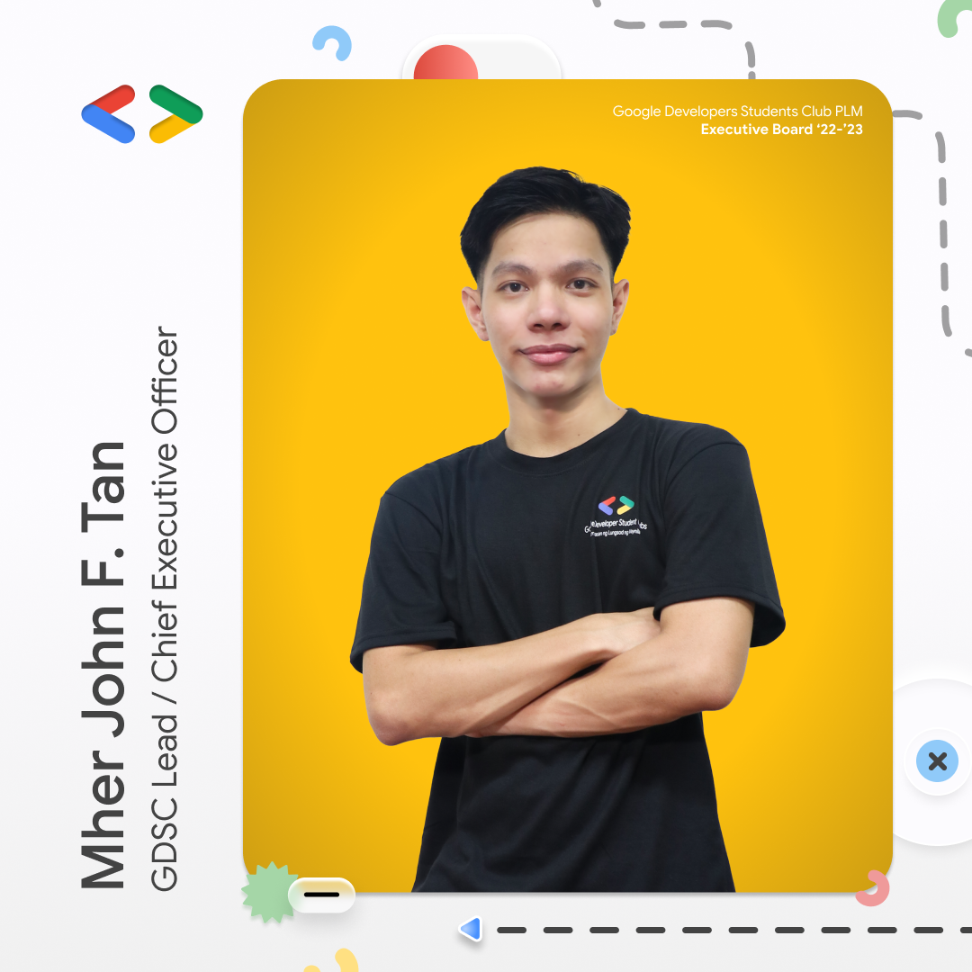
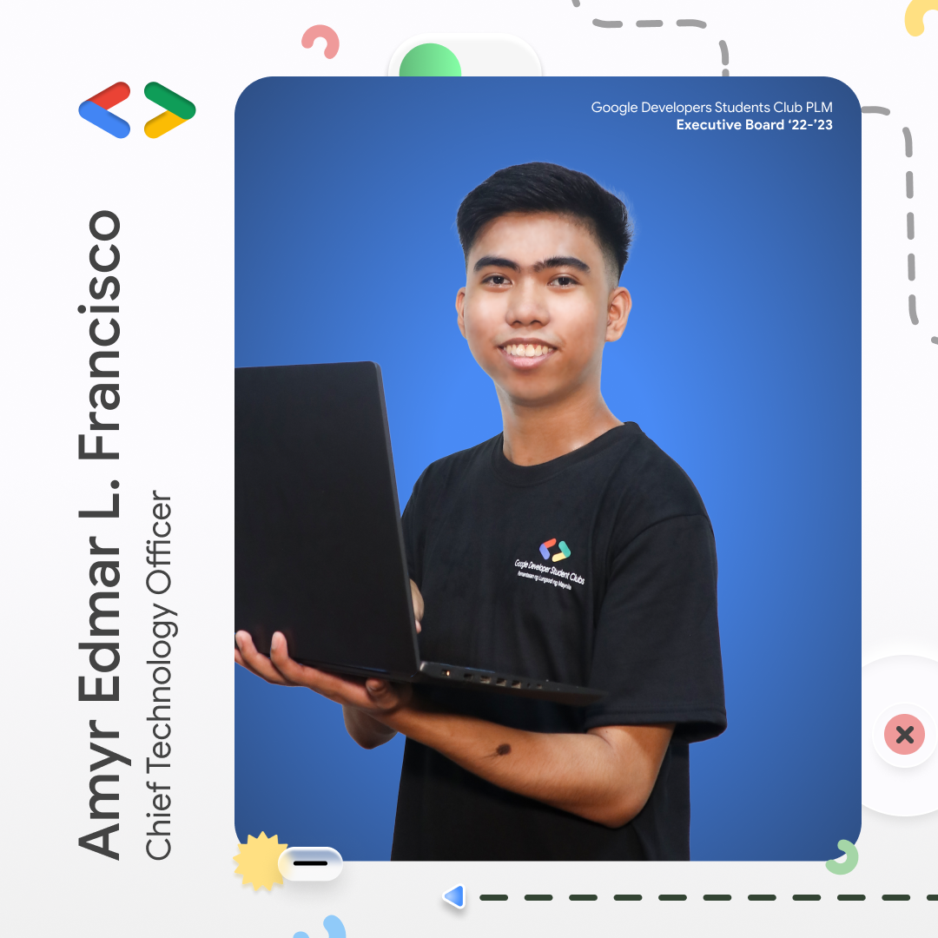
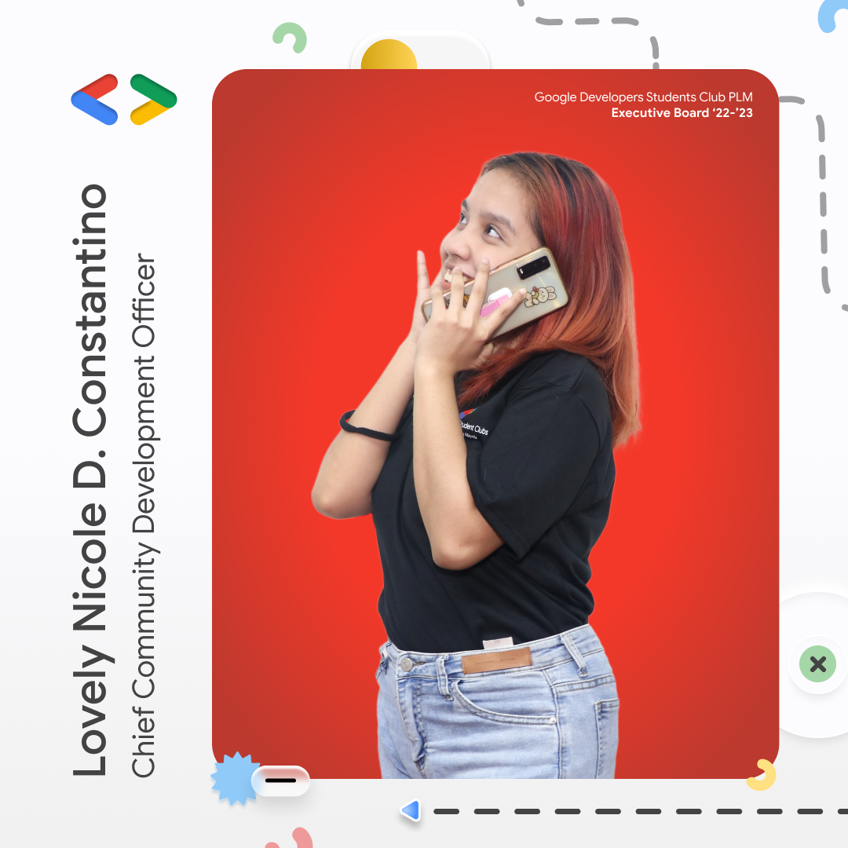
About
Home
Community
Log in
Executive Boards

Slide 21
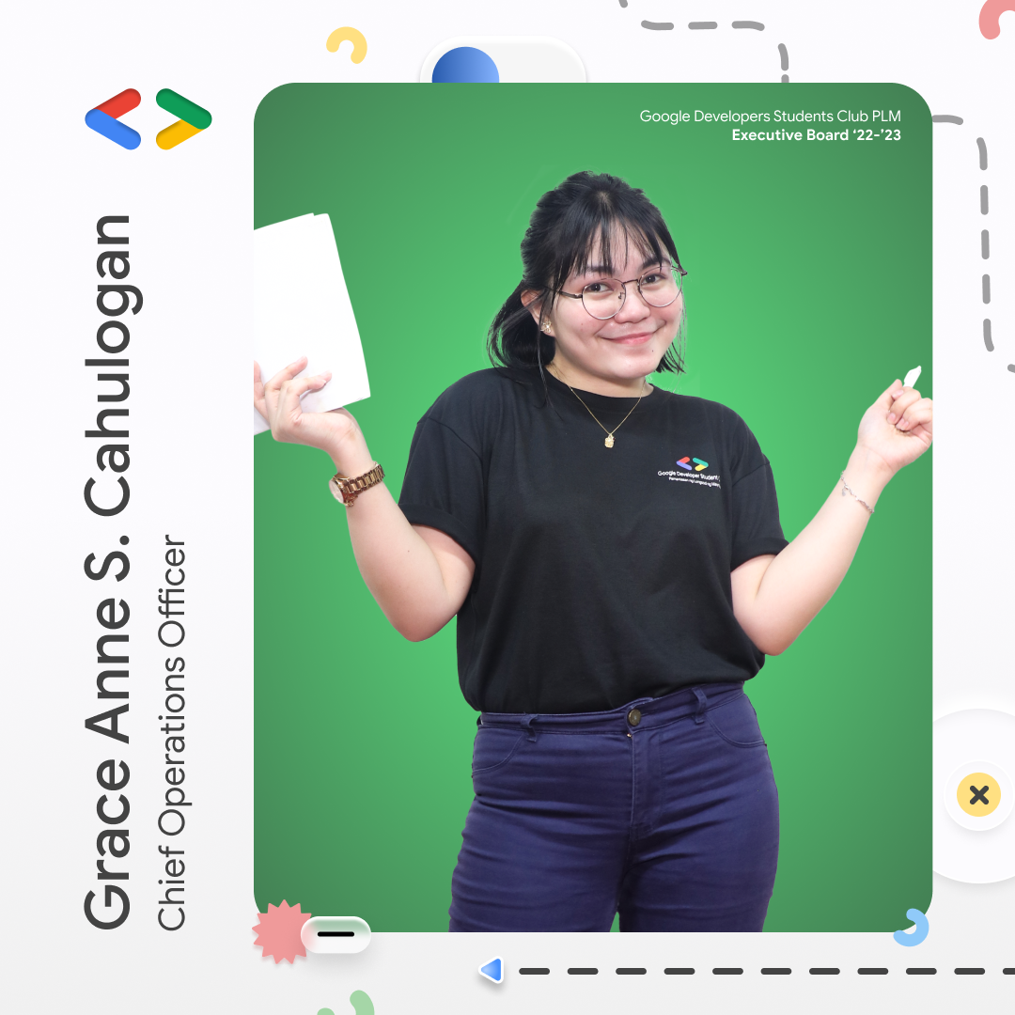
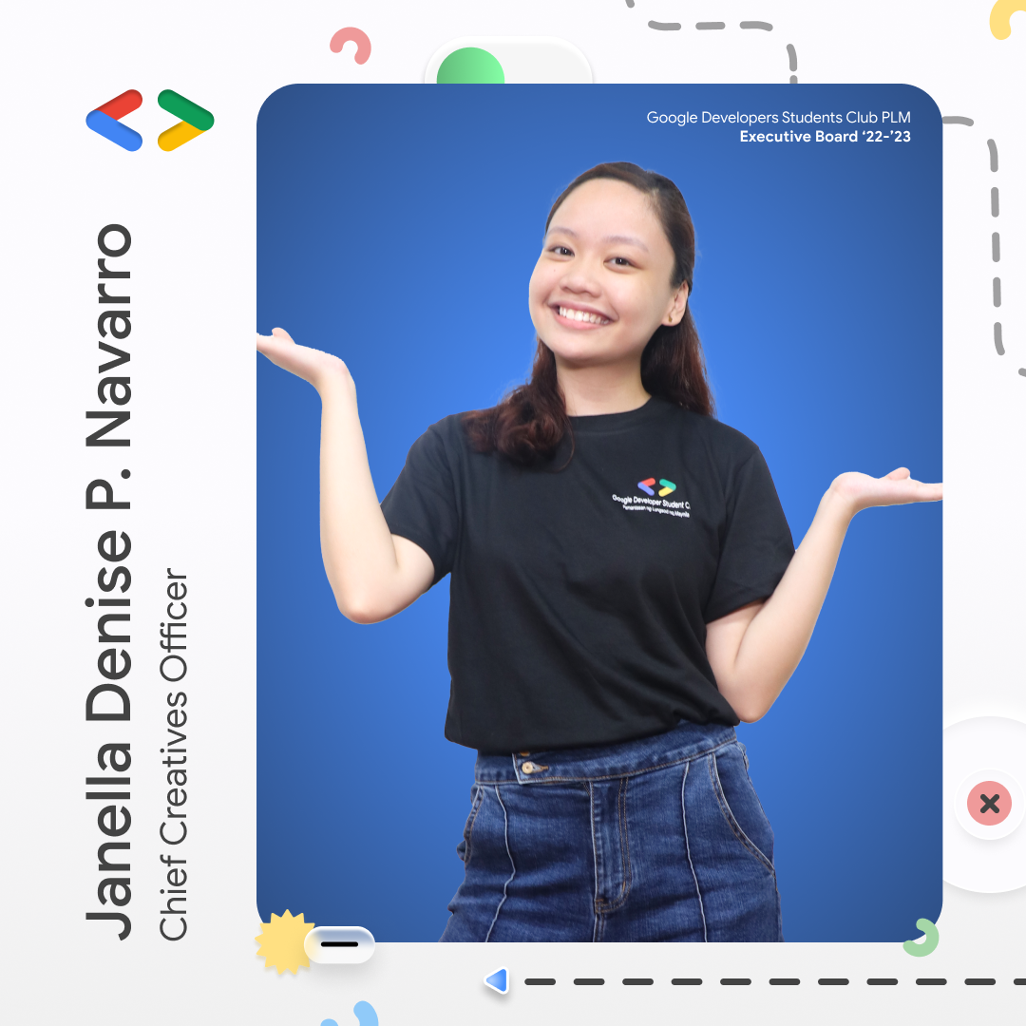
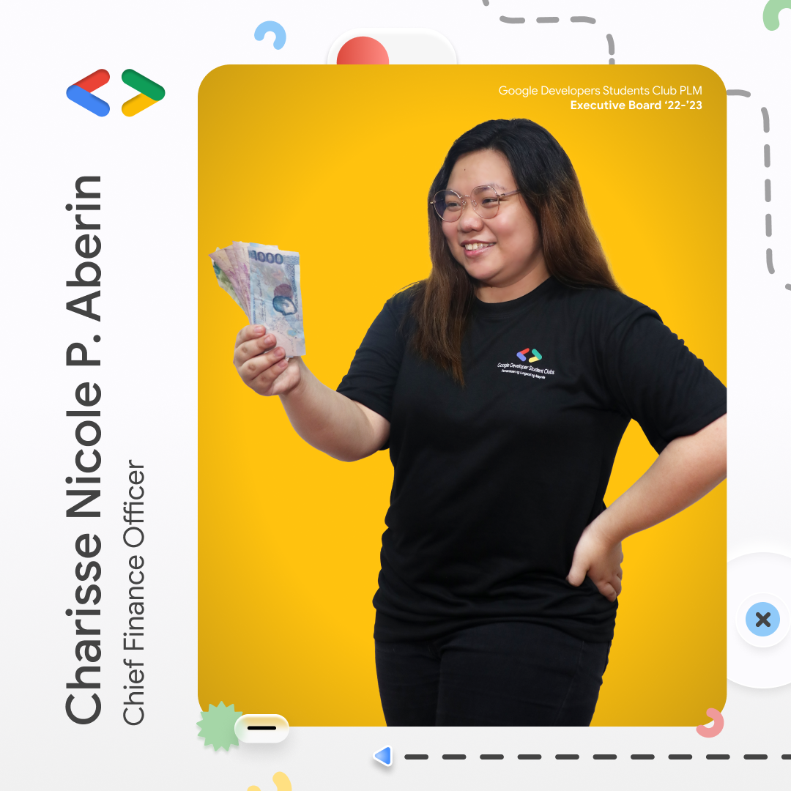
About
Home
Community
Log in
Organizers

Slide 22
About
Home
Community
Log in
Organizers

Slide 23
Home
About
Community
Log in
WELCOME TO GDSC (PLM)

Slide 24
Help
Home
Community
Log in
HARIBOT IS HERE! (FAQ)
NEED HELP?
WHAT IF?
WHAT IF 2?
WHAT IF 3?
WHAT IF 4?
WHAT IF 5?

Slide 25
Help
Home
Community
Log in
HARIBOT IS HERE! (FAQ)
WHAT IF?
Great Great Taste White If Crema combines the real coffee taste with rich vanilla cream for a creamy linamnam that is reminiscent of everyone’s favorite latte.
WHAT IF 2?
WHAT IF 3?
WHAT IF 4?

Slide 26
Help
Home
Community
Log in
HARIBOT IS HERE! (FAQ)
WHAT IF?
WHAT IF 2?
WHAT IF 3?
WHAT IF 4?
WHAT IF 5?

Slide 27
Home
About
Community
Log in
WELCOME TO GDSC (PLM)

Slide 28

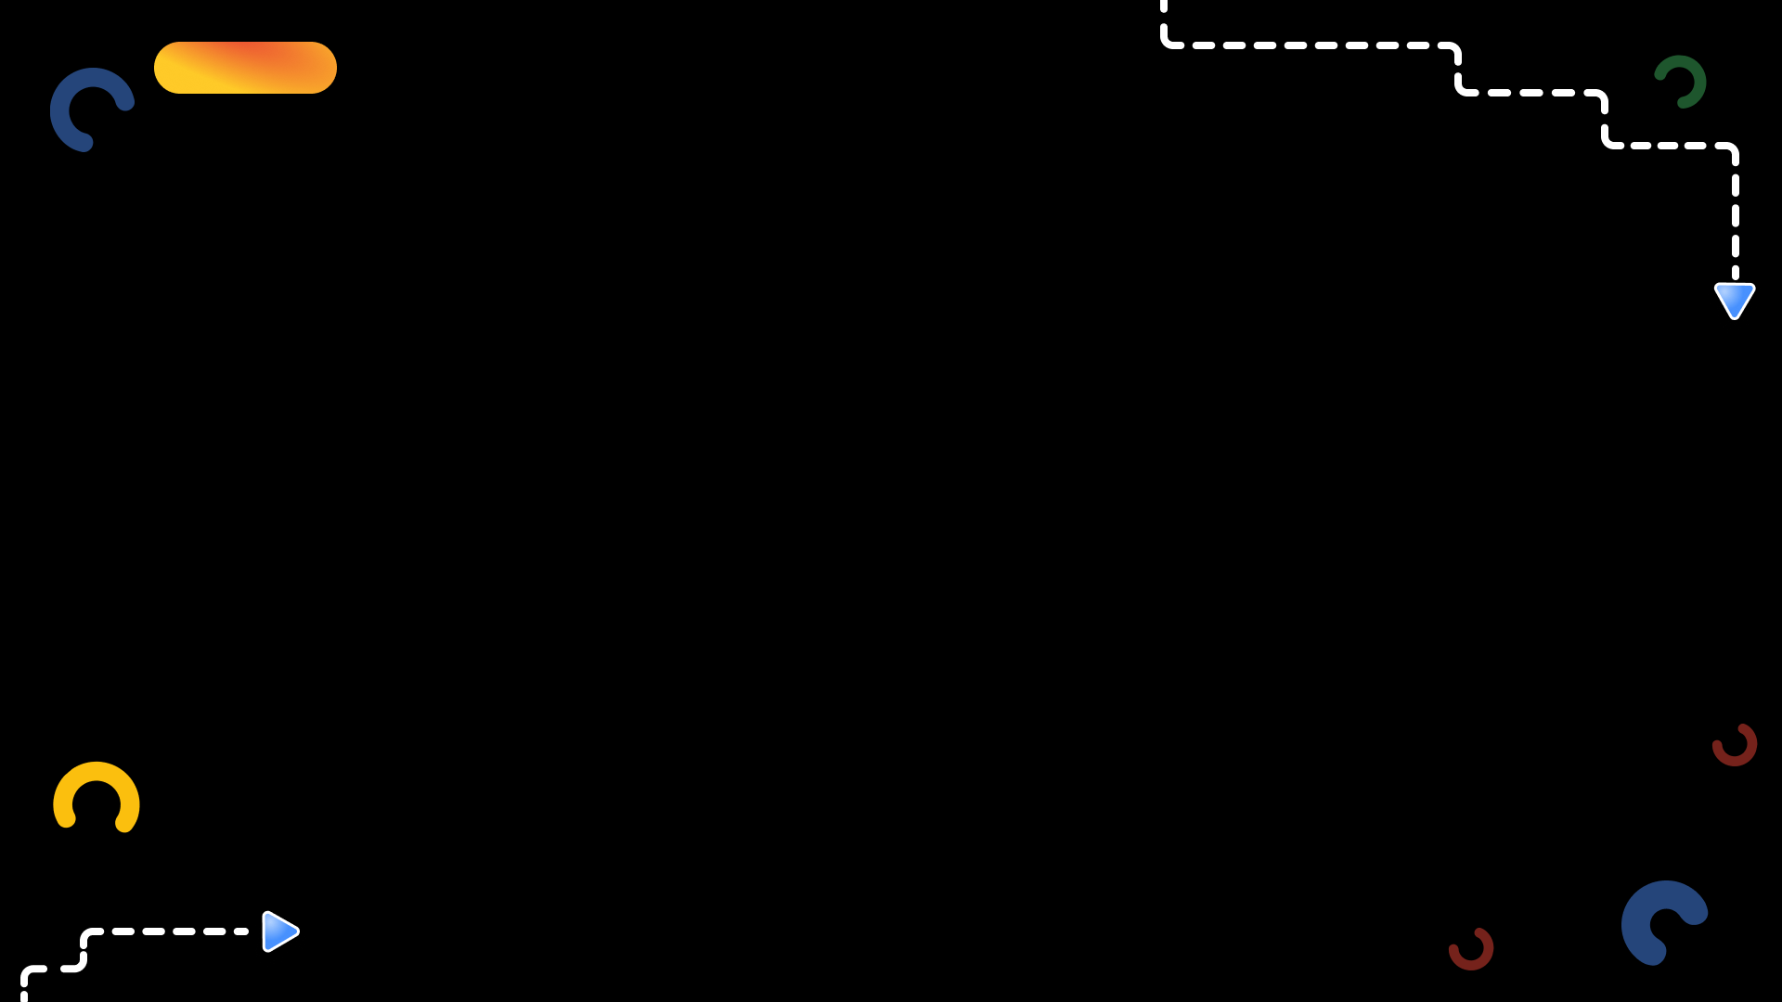

Home
About
Community
Log in
WELCOME TO GDSC (PLM)

Slide 29
Home
About
Community
Log in
WELCOME TO GDSC (PLM)

Slide 30
Login
SIGN UP
Danastig@gmail.com
Email
********
Password
********
Confirm Password
Sign Up

Slide 31
Sign Up
LOGIN
Danastig@gmail.com
Email
********
Password
Login

Slide 32
MORE UPDATES COMING!
Group 4
Leader: Mandu
Member:
Dani
Brie
Jerjer

